Slide 1
Assignment 2
Block Gibbs sampling for Bayesian random effects models with improper priors: convergence and regeneration
Henrique Ennes
Computational Statistics
Professor: Luiz Max de Carvalho
03/12/2021

Slide 2
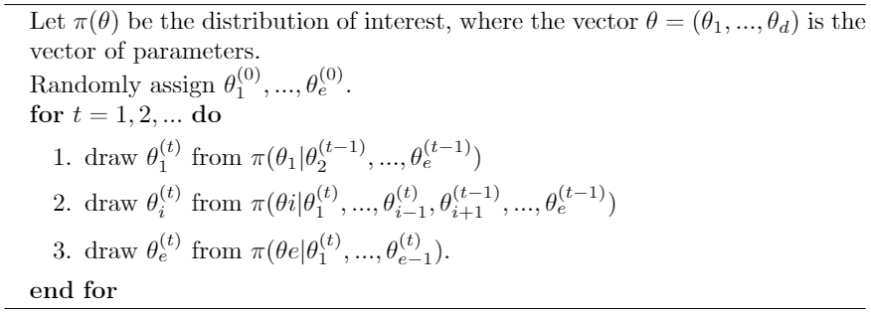
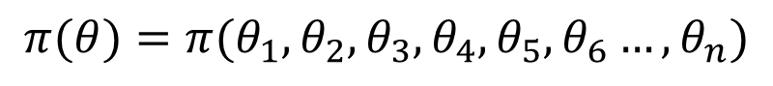
The Model
$$π(θ)=π(θ_{1}, θ_{2}, θ_{3}, θ_{4},θ_{5},θ_{6}…,θ_{n})$$

Slide 3
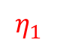
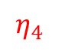
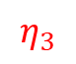
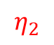
The Model
$$η_{1}$$
$$η_{2}$$
$$η_{3}$$
$$η_{4}$$
$$π(θ)=π(θ_{1}, θ_{2}, θ_{3}, θ_{4},θ_{5},θ_{6}…,θ_{n})$$

Slide 4
The Model
$$η_{1}$$
$$η_{2}$$
$$η_{3}$$
$$η_{4}$$
$$π\left(θ\right)=π\left(θ_{1}, θ_{2}, θ_{3}, θ_{4},θ_{5},θ_{6}…,θ_{n}\right)=π\left(η_{1},…,η_{m}\right)$$

Slide 5
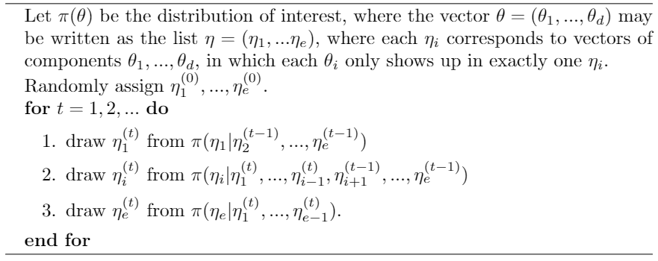
The Model
$$η_{1}$$
$$η_{2}$$
$$η_{3}$$
$$η_{4}$$
$$π\left(θ\right)=π\left(θ_{1}, θ_{2}, θ_{3}, θ_{4},θ_{5},θ_{6}…,θ_{n}\right)=π\left(η_{1},…,η_{m}\right)$$

Slide 6
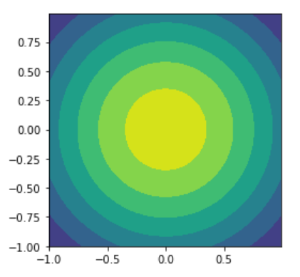
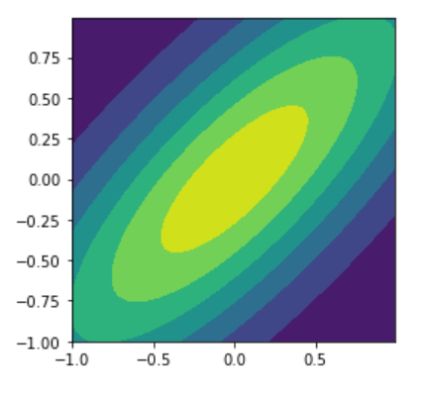
To block or not to block?

Slide 7
To block or not to block?

Slide 8
To block or not to block?

Slide 9
To block or not to block?

Slide 10
To block or not to block?

Slide 11
To block or not to block?

Slide 12
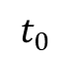
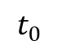
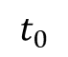
To block or not to block?
$$t_{0}$$
$$t_{0}$$
$$t_{0}$$

Slide 13
To block or not to block?

Slide 14
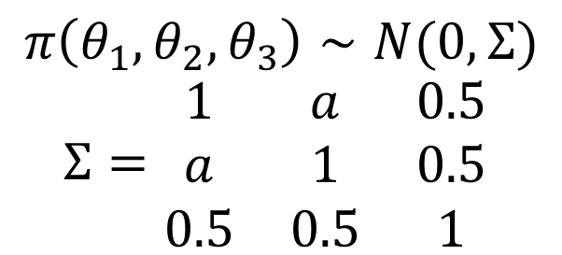
To block or not to block?
$$π\left(θ_{1},θ_{2},θ_{3}\right)∼N(0, Σ)$$
$Σ=\begin{matrix}1 & a & 0.5 \\ a & 1 & 0.5 \\ 0.5 & 0.5 & 1\end{matrix}$

Slide 15
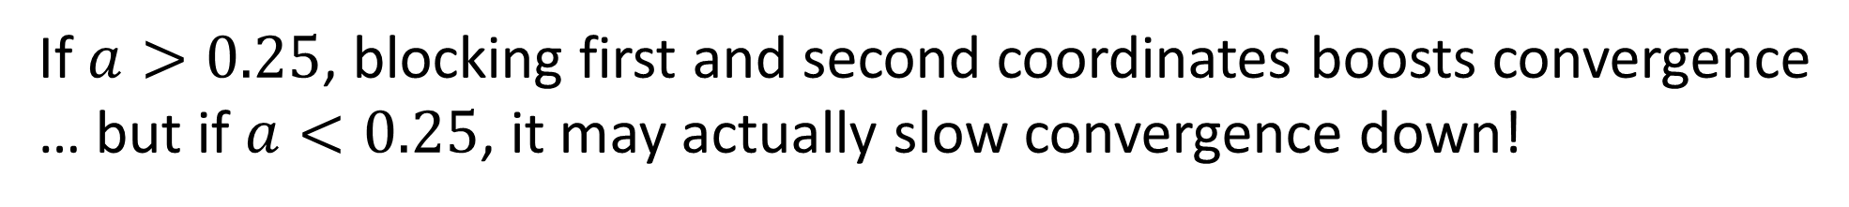
To block or not to block?
$$π\left(θ_{1},θ_{2},θ_{3}\right)∼N(0, Σ)$$
$Σ=\begin{matrix}1 & a & 0.5 \\ a & 1 & 0.5 \\ 0.5 & 0.5 & 1\end{matrix}$
If $a>0.25$, blocking first and second coordinates boosts convergence
… but if $a<0.25$, it may actually slow convergence down!

Slide 16
To block or not to block?
$$π\left(θ_{1},θ_{2},θ_{3}\right)∼N(0, Σ)$$
$Σ=\begin{matrix}1 & a & 0.5 \\ a & 1 & 0.5 \\ 0.5 & 0.5 & 1\end{matrix}$
If $a>0.25$, blocking first and second coordinates boosts convergence

Slide 17
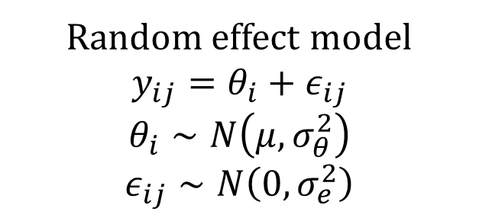

The Model
Random effect model
$$y_{ij}=θ_{i}+ε_{ij}$$
$$θ_{i}∼N\left(μ, σ_{θ}^{2}\right)$$
$ε_{ij}∼N\left(0,σ_{e}^{2}\right)$
Measurement | Worker 1 | Worker 2 | Worker 3 | Worker 4 | Worker 5
1 | 13.4 | 11.0 | 33.4 | 04.2 | 12.4
2 | 9.1 | 13.5 | 20.2 | 13.2 | 12.4
3 | 16.4 | 9.2 | 23.4 | 15.3 | 17.9

Slide 18
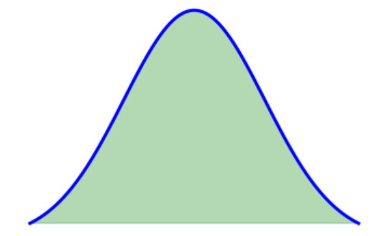

The Model
Random effect model
$$y_{ij}=θ_{i}+ε_{ij}$$
$$θ_{i}∼N\left(μ, σ_{θ}^{2}\right)$$
$ε_{ij}∼N\left(0,σ_{e}^{2}\right)$
$$θ_{i}$$
Measurement | Worker 1 | Worker 2 | Worker 3 | Worker 4 | Worker 5
1 | 13.4 | 11.0 | 33.4 | 04.2 | 12.4
2 | 9.1 | 13.5 | 20.2 | 13.2 | 12.4
3 | 16.4 | 9.2 | 23.4 | 15.3 | 17.9

Slide 19
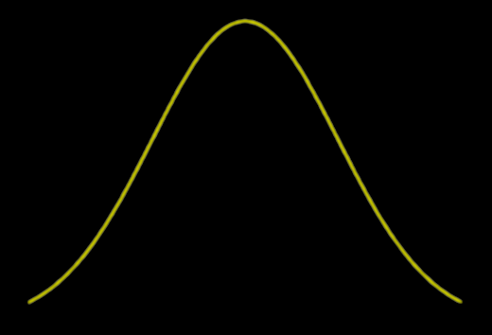
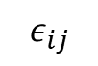
The Model
Random effect model
$$y_{ij}=θ_{i}+ε_{ij}$$
$$θ_{i}∼N\left(μ, σ_{θ}^{2}\right)$$
$ε_{ij}∼N\left(0,σ_{e}^{2}\right)$
$$ε_{ij}$$
$$θ_{i}$$
Measurement | Worker 1 | Worker 2 | Worker 3 | Worker 4 | Worker 5
1 | 13.4 | 11.0 | 33.4 | 04.2 | 12.4
2 | 9.1 | 13.5 | 20.2 | 13.2 | 12.4
3 | 16.4 | 9.2 | 23.4 | 15.3 | 17.9

Slide 20
The Model
Random effect model
$$y_{ij}=θ_{i}+ε_{ij}$$
$$θ_{i}∼N\left(μ, σ_{θ}^{2}\right)$$
$ε_{ij}∼N\left(0,σ_{e}^{2}\right)$
$$π\left(θ, μ, σ_{θ}^{2},σ_{e}^{2} | y\right)∼f\left(y | θ, μ, σ_{θ}^{2},σ_{e}^{2}\right) p\left(θ, μ, σ_{θ}^{2},σ_{e}^{2}\right)∼f\left(y_{i} | θ, μ, σ_{θ}^{2},σ_{e}^{2}\right) π\left(θ|μ, σ_{θ}^{2},σ_{e}^{2}\right)π_{a,b}(μ,σ_{θ}^{2},σ_{e}^{2})$$

Slide 21
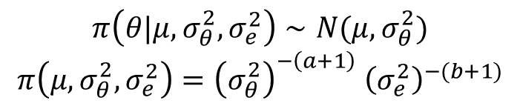
The Model
Random effect model
$$y_{ij}=θ_{i}+ε_{ij}$$
$$θ_{i}∼N\left(μ, σ_{θ}^{2}\right)$$
$ε_{ij}∼N\left(0,σ_{e}^{2}\right)$
$$π\left(θ, μ, σ_{θ}^{2},σ_{e}^{2} | y\right)∼f\left(y | θ, μ, σ_{θ}^{2},σ_{e}^{2}\right) p\left(θ, μ, σ_{θ}^{2},σ_{e}^{2}\right)∼f\left(y_{i} | θ, μ, σ_{θ}^{2},σ_{e}^{2}\right) π\left(θ|μ, σ_{θ}^{2},σ_{e}^{2}\right)π_{a,b}(μ,σ_{θ}^{2},σ_{e}^{2})$$
$$π\left(θ|μ, σ_{θ}^{2},σ_{e}^{2}\right)∼N(μ,σ_{θ}^{2})$$
$$π\left(μ,σ_{θ}^{2},σ_{e}^{2}\right)={\left(σ_{θ}^{2}\right)}^{−\left(a+1\right)} {\left(σ_{e}^{2}\right)}^{−(b+1)}$$

Slide 22
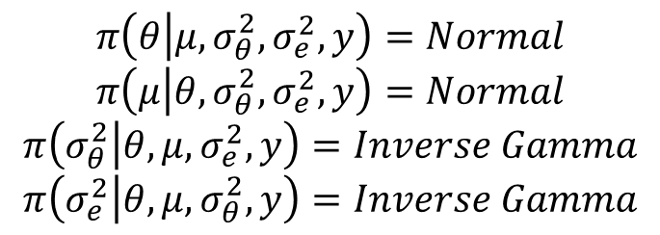
The Model
Random effect model
$$y_{ij}=θ_{i}+ε_{ij}$$
$$θ_{i}∼N\left(μ, σ_{θ}^{2}\right)$$
$ε_{ij}∼N\left(0,σ_{e}^{2}\right)$
$$π\left(θ, μ, σ_{θ}^{2},σ_{e}^{2} | y\right)∼f\left(y | θ, μ, σ_{θ}^{2},σ_{e}^{2}\right) p\left(θ, μ, σ_{θ}^{2},σ_{e}^{2}\right)∼f\left(y_{i} | θ, μ, σ_{θ}^{2},σ_{e}^{2}\right) π\left(θ|μ, σ_{θ}^{2},σ_{e}^{2}\right)π_{a,b}(μ,σ_{θ}^{2},σ_{e}^{2})$$
$$π\left(θ|μ, σ_{θ}^{2},σ_{e}^{2}\right)∼N(μ,σ_{θ}^{2})$$
$$π\left(μ,σ_{θ}^{2},σ_{e}^{2}\right)={\left(σ_{θ}^{2}\right)}^{−\left(a+1\right)} {\left(σ_{e}^{2}\right)}^{−(b+1)}$$
$$π\left(θ | μ,σ_{θ}^{2},σ_{e}^{2}, y\right)=Normal$$
$$π\left(μ | θ,σ_{θ}^{2},σ_{e}^{2}, y\right)=Normal$$
$$π\left(σ_{θ}^{2} | θ, μ,σ_{e}^{2},y\right)=Inverse Gamma$$
$$π\left(σ_{e}^{2} | θ, μ,σ_{θ}^{2},y\right)=Inverse Gamma$$

Slide 23
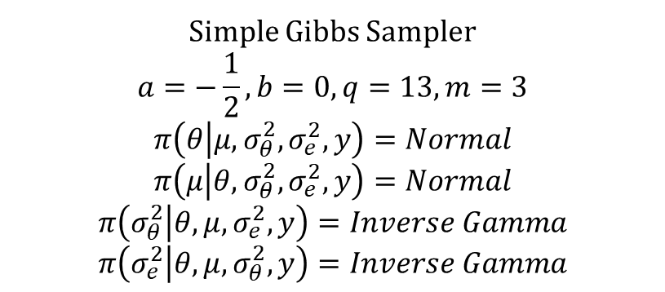
The Model
Simple Gibbs Sampler
$$a=−\frac{1}{2},b=0, q=13, m=3$$
$$π\left(θ | μ,σ_{θ}^{2},σ_{e}^{2}, y\right)=Normal$$
$$π\left(μ | θ,σ_{θ}^{2},σ_{e}^{2}, y\right)=Normal$$
$$π\left(σ_{θ}^{2} | θ, μ,σ_{e}^{2},y\right)=Inverse Gamma$$
$$π\left(σ_{e}^{2} | θ, μ,σ_{θ}^{2},y\right)=Inverse Gamma$$

Slide 24
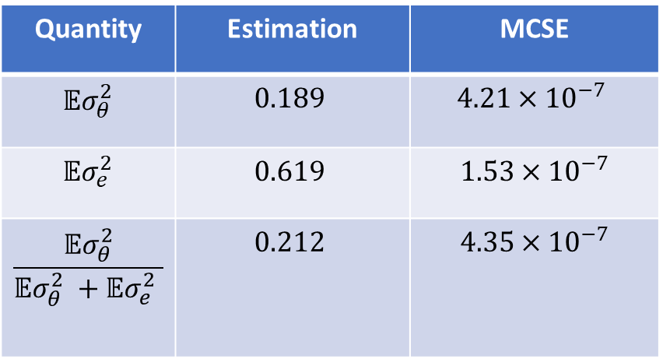
The Model
Simple Gibbs Sampler
$$a=−\frac{1}{2},b=0, q=13, m=3$$
$$π\left(θ | μ,σ_{θ}^{2},σ_{e}^{2}, y\right)=Normal$$
$$π\left(μ | θ,σ_{θ}^{2},σ_{e}^{2}, y\right)=Normal$$
$$π\left(σ_{θ}^{2} | θ, μ,σ_{e}^{2},y\right)=Inverse Gamma$$
$$π\left(σ_{e}^{2} | θ, μ,σ_{θ}^{2},y\right)=Inverse Gamma$$
Quantity | Estimation | MCSE
$${𝔼σ}_{θ}^{2}$$ | $$0.189$$ | $$4.21×{10}^{−7}$$
$${𝔼σ}_{e}^{2}$$ | $$0.619$$ | $$1.53×{10}^{−7}$$
$$\frac{{𝔼σ}_{θ}^{2}}{{𝔼σ}_{θ}^{2} +{𝔼σ}_{e}^{2} }$$ | $$0.212$$ | $$4.35×{10}^{−7}$$

Slide 25
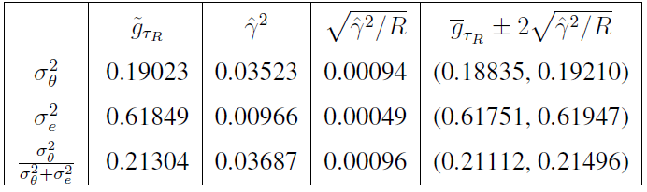
The Model
Simple Gibbs Sampler
$$a=−\frac{1}{2},b=0, q=13, m=3$$
$$π\left(θ | μ,σ_{θ}^{2},σ_{e}^{2}, y\right)=Normal$$
$$π\left(μ | θ,σ_{θ}^{2},σ_{e}^{2}, y\right)=Normal$$
$$π\left(σ_{θ}^{2} | θ, μ,σ_{e}^{2},y\right)=Inverse Gamma$$
$$π\left(σ_{e}^{2} | θ, μ,σ_{θ}^{2},y\right)=Inverse Gamma$$
Quantity | Estimation | MCSE
$${𝔼σ}_{θ}^{2}$$ | $$0.189$$ | $$4.21×{10}^{−7}$$
$${𝔼σ}_{e}^{2}$$ | $$0.619$$ | $$1.53×{10}^{−7}$$
$$\frac{{𝔼σ}_{θ}^{2}}{{𝔼σ}_{θ}^{2} +{𝔼σ}_{e}^{2} }$$ | $$0.212$$ | $$4.35×{10}^{−7}$$

Slide 26
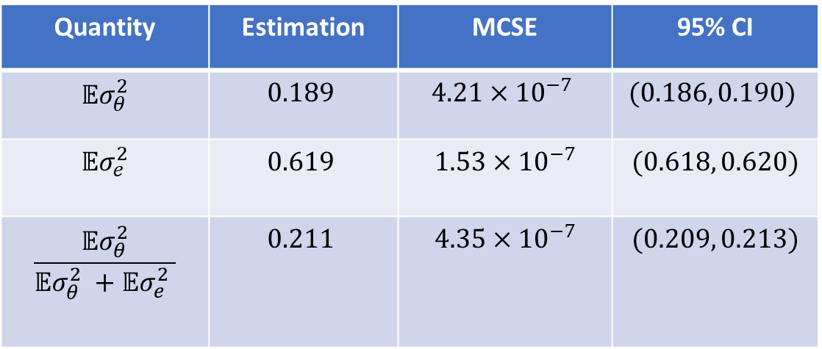
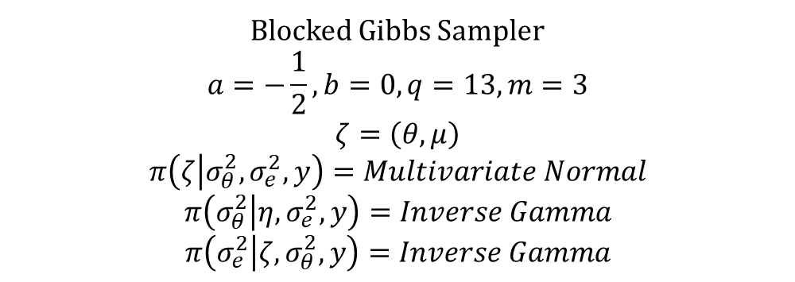
Blocked Gibbs Sampler
Blocked Gibbs Sampler
$$a=−\frac{1}{2},b=0, q=13, m=3$$
$$ζ=\left(θ, μ\right)$$
$$π\left(ζ | σ_{θ}^{2},σ_{e}^{2}, y\right)=Multivariate Normal$$
$$π\left(σ_{θ}^{2} | η, σ_{e}^{2},y\right)=Inverse Gamma$$
$$π\left(σ_{e}^{2} | ζ,σ_{θ}^{2},y\right)=Inverse Gamma$$
Quantity | Estimation | MCSE | 95% CI
$${𝔼σ}_{θ}^{2}$$ | $$0.189$$ | $$4.21×{10}^{−7}$$ | $$(0.186, 0.190)$$
$${𝔼σ}_{e}^{2}$$ | $$0.619$$ | $$1.53×{10}^{−7}$$ | $$(0.618, 0.620)$$
$$\frac{{𝔼σ}_{θ}^{2}}{{𝔼σ}_{θ}^{2} +{𝔼σ}_{e}^{2} }$$ | $$0.211$$ | $$4.35×{10}^{−7}$$ | $$(0.209, 0.213)$$

Slide 27
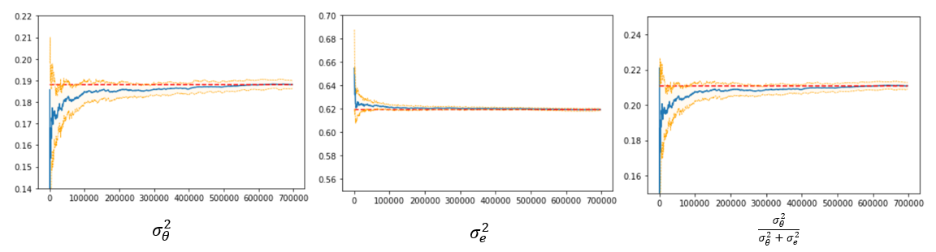
Blocked Gibbs Sampler
Blocked Gibbs Sampler
$$a=−\frac{1}{2},b=0, q=13, m=3$$
$$ζ=\left(θ, μ\right)$$
$$π\left(ζ | σ_{θ}^{2},σ_{e}^{2}, y\right)=Multivariate Normal$$
$$π\left(σ_{θ}^{2} | η, σ_{e}^{2},y\right)=Inverse Gamma$$
$$π\left(σ_{e}^{2} | ζ,σ_{θ}^{2},y\right)=Inverse Gamma$$

Slide 28
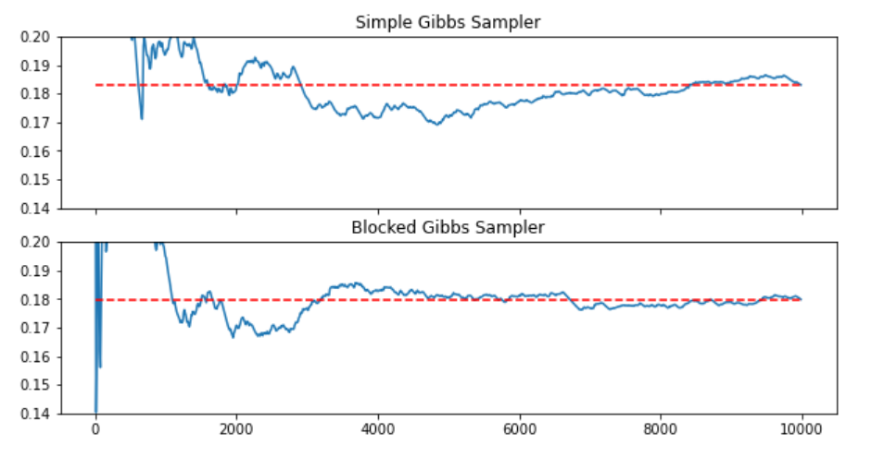
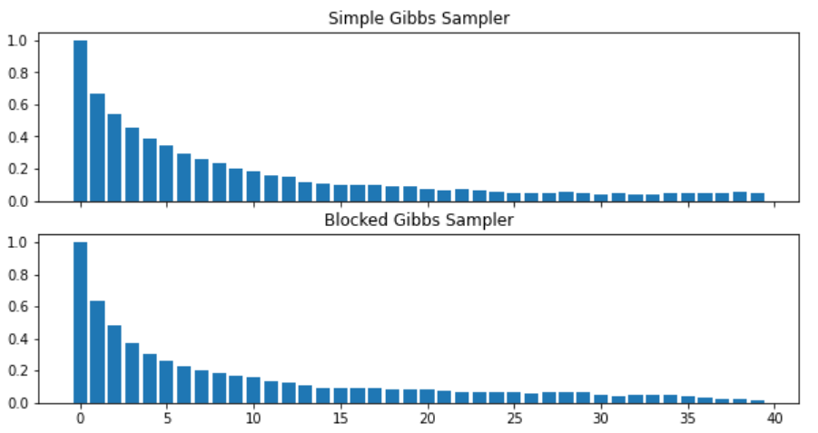
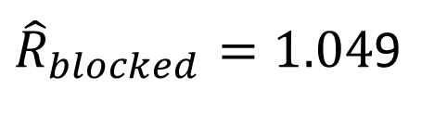
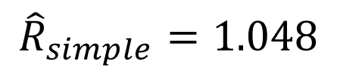
Simple vs. Blocked Gibbs Sampler
$${\hat{R}}_{simple}=1.048$$
${\hat{R}}_{blocked}=1.04$9

Slide 29
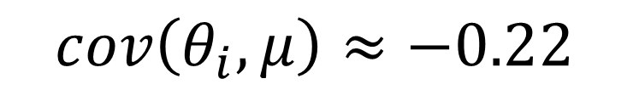
Simple vs. Blocked Gibbs Sampler
$${\hat{R}}_{simple}=1.048$$
$$cov\left(θ_{i}, μ\right)≈−0.22$$
${\hat{R}}_{blocked}=1.04$9

Slide 30
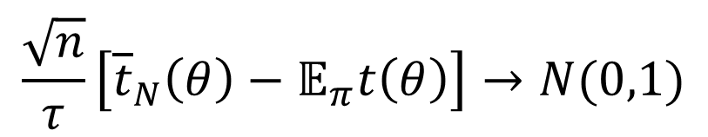
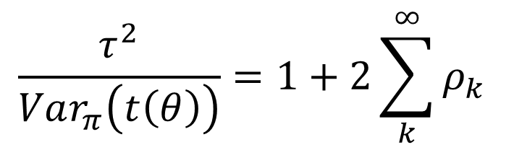
Why to go with blocks?
If the chain is geometric ergodic and $t^{2+α}(θ)$ is integrable for some $α>0$ under the target $π$, then
$$\frac{\sqrt{n}}{τ}\left[{\overline{t}}_{N}\left(θ\right)−𝔼_{π}t\left(θ\right)\right]→N(0,1)$$
$$\frac{τ^{2}}{Var_{π}\left(t\left(θ\right)\right)}=1+2\sum_{k}^{∞}{ρ_{k} }$$

Slide 31
Why to go with blocks?
If the chain is geometric ergodic and $t^{2+α}(θ)$ is integrable for some $α>0$ under the target $π$, then
$$\frac{\sqrt{n}}{τ}\left[{\overline{t}}_{N}\left(θ\right)−𝔼_{π}t\left(θ\right)\right]→N(0,1)$$
$$\frac{τ^{2}}{Var_{π}\left(t\left(θ\right)\right)}=1+2\sum_{k}^{∞}{ρ_{k} }$$
[Tan and Hobert (2009)] provide proof for geometric ergodicity in the blocked case

